Slide 1
Micro-controller basics 1
(Give a Reading of this Slide)
Arnab Bhattacharjee
Lecturer, Department of CSE,
United International University
Email id : arnab@cse.uiu.ac.bd
Courtesy: Nasif M. Sir,
Md. Shafqat Talukder Rakin Sir

Slide 2
Topics
Difference between Micro-processor and Micro-controller.

Slide 3
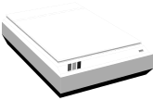
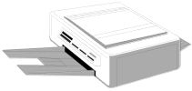
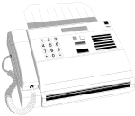
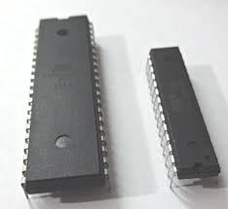

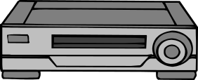

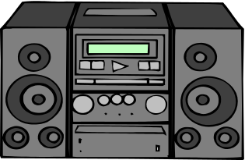

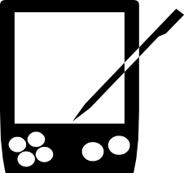
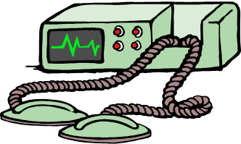

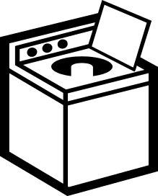
Microprocessor/Microcontroller and some of their applications

Slide 4
Typical Applications of uP
Microprocessor is basically a CPU, using CPU general purpose computer can be built
Desktop computers, PCs, Laptops, Workstations, Servers, Supercomputers
We are in the era of 32- and 64-bit microprocessor, so we can produce very powerful computers

Slide 5
Typical Application of uC
Using microcontrollers embedded systems are produced
An embedded system is a combination of hardware and software built for a specific application
  Consumer electronics making toys, cameras, camcorders, robots
  Consumer products - washing machines, microwave ovens etc.
  Instrumentation - oscilloscopes, various medical equipments,
  Process control - data aquisition, controlling various industries
  Communication – Telephone, answering machines
  Office equipments – Fax, printer, small PABX
  Micromedia application – Cell phones, PDAs, teleconferencing equipment

Slide 6
Microprocessor vs Microcontroller
Microprocessor | Microcontroller
1. A silicon chip representing a central processing unit (CPU), which is capable of performing arithmetic as well as logical operations according to a pre-defined set of instructions. | 1. A microcontroller is a highly integrated chip that contains a CPU, RAM, special and general purpose register arrays, on chip flash memory for program storage, timer and interrupt control units and dedicated I/O ports.
2. It is a dependent unit. It requires the combination of other chips like timers, program and data memory chips, interrupt controllers etc. for functionality. | 2. It is a self-contained unit and it does not require external interrupt controller, timer, UART etc. for it's functioning.
3. Most of the time general purpose in design and operation. | 3. Mostly application-oriented.
4. Targeted for high end market where performance is important. | 4. Targeted for embedded market where performance is not so critical.
5. Limited power saving options compared to microcontrollers. | 5. Includes lot of power saving features.

Slide 7
Criteria for choosing a microcontroller or a microprocessor

Slide 8
Criteria for choosing a microcontroller
The first and foremost criterion in choosing a microcontroller is that it must meet the task at hand efficiently and cost effectively
In analyzing the need of a microcontroller based project, we must see whether an 8-bit, 16-bit or 32-bit microcontroller can best handle the computing needs of the task most effectively.

Slide 9
Criteria for choosing a microcontroller
Among other considerations in this category are:
  Speed: What is the highest speed that the microcontroller supports?
  (b) Power Consumption: critical for battery powered products
  (c) The amount of ROM and RAM on chip
  (d ) The number of I/O pins & Analog to Digital conversion support
  (e) Cost per unit

Slide 10
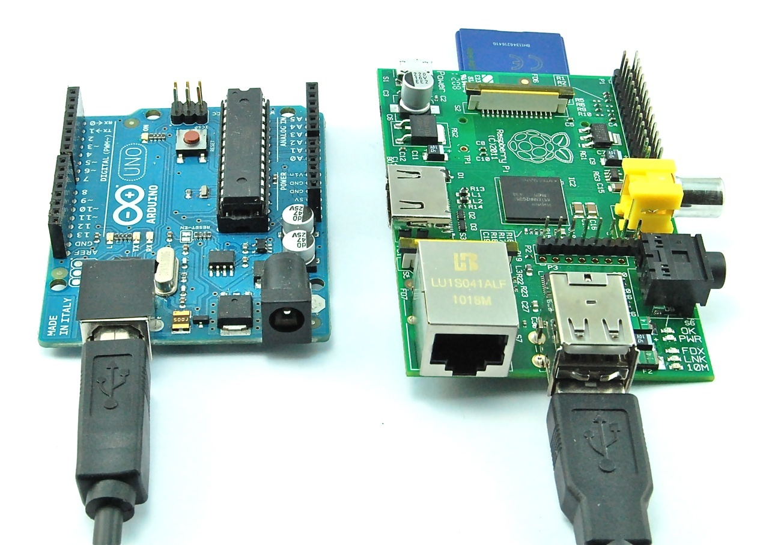
Raspberry pi and Arduino

Slide 11
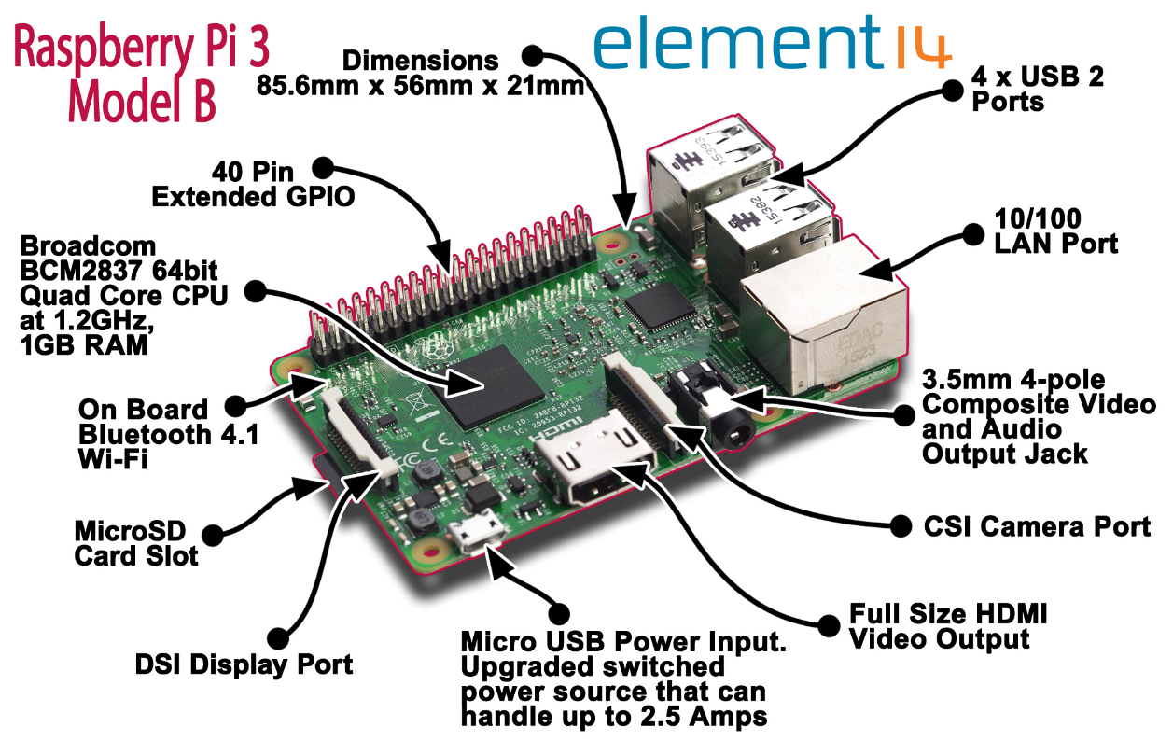

Slide 12
Features of Raspberry pi and Arduino
Raspberry pi | Arduino
The Raspberry Pi is a microprocessor based single-board computer. | The Arduino Uno is a microcontroller based physical computing platform.
Runs a full fledged Linux OS | Runs a single program.
Doesn't support Analog IO | Support for Analogue IO
1.2 Ghz Processor with 1 GB of RAM | 16Mhz processor with 2KB of RAM (Arduino Uno)

Slide 13
How to choose right kind of board?
Investigate the goal of the project.
Find the feature of the board, if it fulfils the goals.
Consider price, CPU processing speed, RAM, Network capability, Power consumption.

Slide 14
Question
Suppose you want to design a system to monitor water level in a water tank at the rooftop of the building. When the water level of the tank is zero (empty), the system automatically switches on the pump motor. The motor is switched off automatically when the water tank is full. The system is communicating with the management station (PC) in your room using I2C protocol. You can use either Micro-processor based system (e.g. Raspberry pi) or Micro-controller based system (e.g. Arduino). Which one you will prefer? To make appropriate choice explain which criteria need to consider?

Slide 15
Types of Computer Architecture

Slide 16
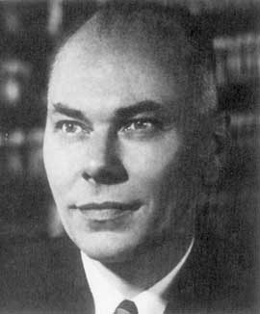
Harvard Architecture
Howard Hathaway Aiken
The Harvard architecture is a computer architecture with physically separate storage and signal pathways for instructions and data.
The term originated from the Harvard Mark I relay-based computer, which stored instructions on punched tape (24 bits wide) and data in electro-mechanical counters.
Notes:
RISC (reduced instruction set computing)

Slide 17
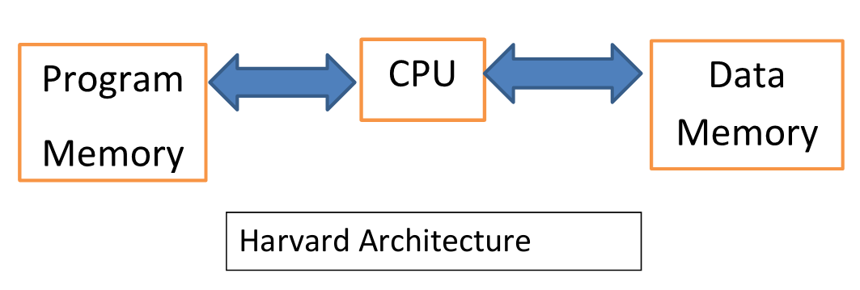
BUS
BUS

Slide 18
Harvard Architecture
In a Harvard architecture, there is no need to make the two memories share characteristics.
In particular, the word width, timing, implementation technology, and memory address structure can differ.
In some systems, instructions can be stored in read memory while data memory generally requires read write memory.

Slide 19
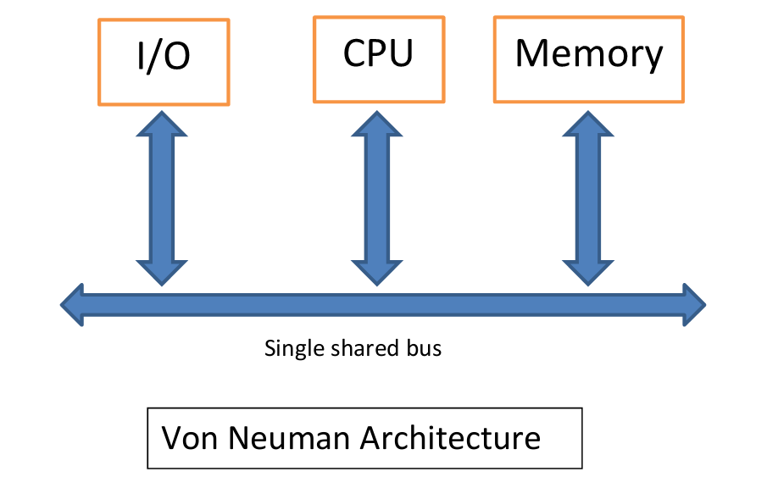

Slide 20
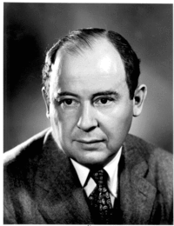
Von Neumann Architecture
John von Neumann
In contrast with the Harvard architecture, the Von Neumann architecture has a single storage structure to hold both instructions and data.
In this architecture, an instruction fetch and a data operation cannot occur at the same time because they share a common bus.
This is referred to as the Von Neumann bottleneck and often limits the performance of the system.
Notes:
CISC (complex instruction set computing)

Slide 21
Harvard Architecture vs Von neuman Architecture
Harvard Architecture | Von neuman Architecture
1. Separate buses for instruction and data fetch. | 1. Single shared bus for instruction and data fetching.
2. Easier to pipeline, so high performance can be achieved | 2. Low performance compared to Harvard architecture
3. Comparatively high cost because of the separate data memory and program memory. | 3. Comparatively cheaper cost because of the single memory is used for storing data and program.
4. Since data memory and program memory are stored physically in different locations, no chance for accidental corruption of program memory. | 4. Since data memory and program memory are stored physically in the same chip, chances for accidental corruption of program memory.

Slide 22
Processor ISA (instruction set architecture): RISC versus CISC
Most PCs use CPU based on CISC architecture. For instance Intel and AMD CPU's are based on CISC architectures.
Many claim that RISC is the architecture of the future.
But even though RISC has been in the market since 1980, it hasn’t managed to kick CISC out of the picture, some argue that if it is really the architecture of the future it should have been able to do this by now.

Slide 23
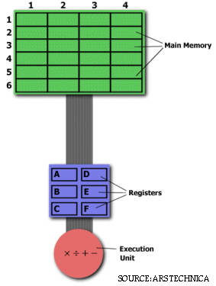
RISC vs CISC
We want to multiply 2:3 with 5:2 and store result to 2:3
CISC
  MULT 2:3, 5:2
RISC
  LOAD A, 2:3
  LOAD B, 5:2
  PROD A, B
  STORE 2:3, A
https://cs.stanford.edu/people/eroberts/courses/soco/projects/risc/risccisc/

Slide 24
RISC (Reduced instruction set computing) VS CISC (Complex instruction set computing)
RISC | CISC
1. Instruction pipelining and increased execution speed. | 1. No instruction pipelining feature.
2. A large number of registers are available. | 2. Limited number of general purpose register.
3. Single, fixed length instruction. | 3. Variable length instruction.
4. Used with Harvard architecture. | 4. Used with Harvard and Von neuman architecture.

Slide 25
Type | Flash | RAM | EEPROM
 | Size, kB | Size, kB | Size, kB
Atmega8 | 8 | 1 | 0.5
Atmega32 | 32 | 2 | 1
Atmega64 | 64 | 4 | 2
Atmega128 | 128 | 4 | 4

Slide 26
Thank You

